Slide 1

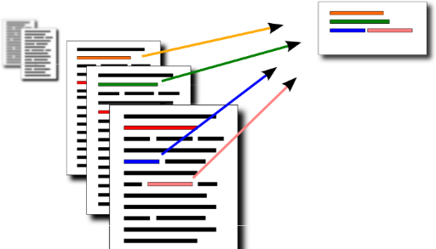
Multidocument summarization Ali lahko povzamem množico besedil brez njihovega razumevanja? Ideja: poišči k ključnih stavkov!

Slide 2
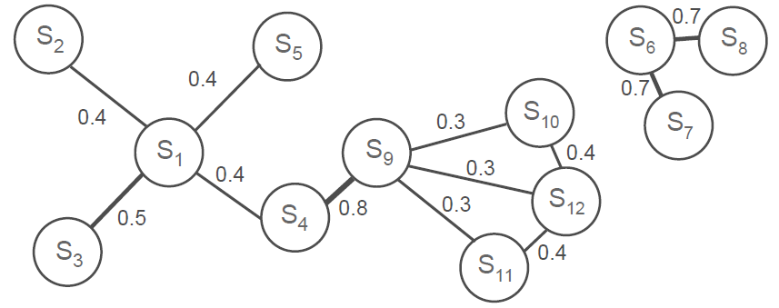
Detect the relation between sentences
Represent document as graph = matrix
Find most important nodes = sentences

Slide 3
Matrix factorization for multidocument summarization
Detect the relation between sentences
Represent document as graph = matrix
Find most important nodes = sentences
Like numbers, matrices can be factored
m•n matrix = m•k times k•n
Use Arcehtypal Analysis
k = number of important sentences
n
P
=
m
k
n
X
•
Y’
k
m

Slide 4

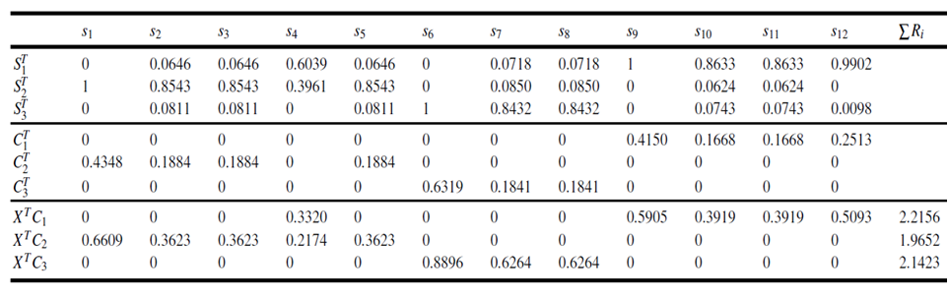
A simple example (the number of archetypes = 3)
= archetype significance
S = cluster membership
C = sentence ranking

Slide 5
Multi-document summarization
Given: a set of textual documents
Find: a small subset of sentences that best summarize the contents of all documents
_______________________________________
Sentences in the summary correspond to Archetypes
No need to have separate documents (join them)
Input matrix describes the relation between sentences
No need for advanced NLP
Competitive results when compared with advanced and much more complicated methods
One can add advanced NLP to improve results

Slide 6

Multi-document summarization
n sentences : matrix T
We need also the sentence similarity matrix: A
A = relation between sentences
T = description of each sentence
We can combine both matrices into the input (content-graph joint) matrix as a product X =TA

Slide 7
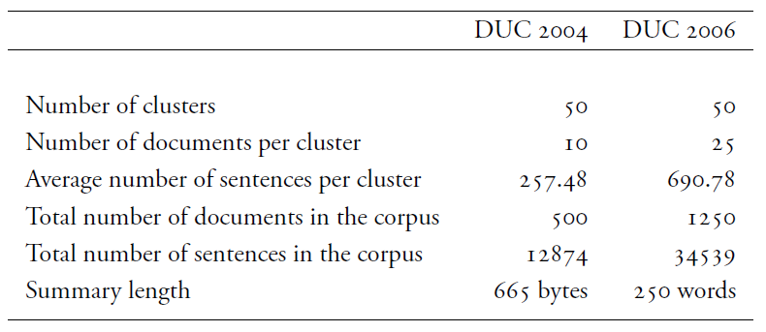
Experimental comparison

Slide 8
Experimental comparison
Recall Oriented Understudy for Gisting Evaluation ROUGE-N: how well a machine summary overlaps with human summaries using the N-gram co-occurrence statistics.
(N-gram is a contiguous sequence of N words)

Slide 9
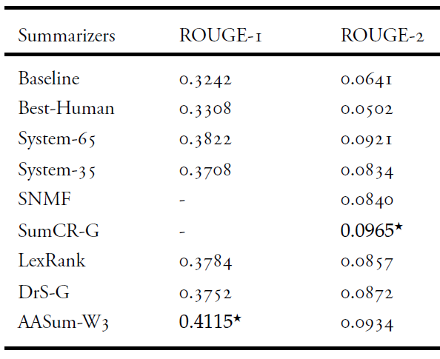

Experimental comparison (DUC2004)

Slide 10
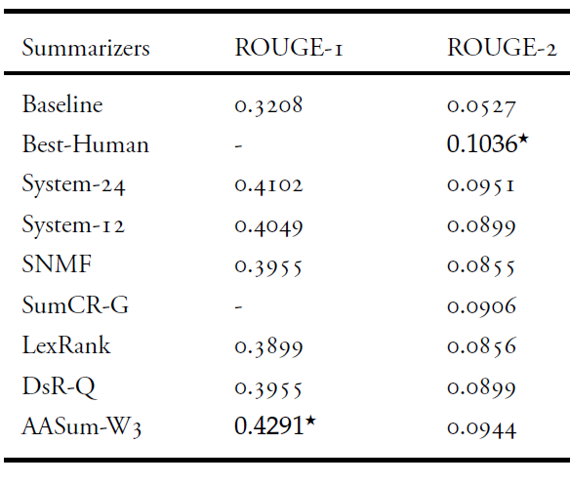
Experimental comparison (DUC2006)

